Slide 1
Safeway’s Automation Strategy
Automatic Shelf Inventory Count

Slide 2

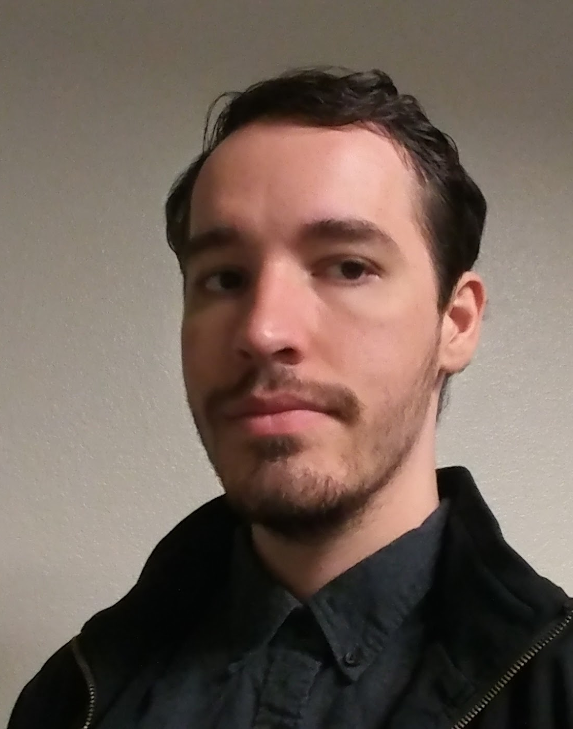

SAS Consultancy Team Members:
Srivatsav Vuddamarry
Product Management and
Business Strategy
Anderson Klein
Team’s Analyst and Technical Expert
Sankalp Thakur
Automation and Policies Expert

Slide 3
As - Is : (Safeway)
The Safeway App does not have a live shelf inventory tracking system.
Boo !!! You are wasting a lot of time by going to the store and you start hating Safeway.
Basic Supply chain management
To - Be : (Safeway 2.0)
App displays the live inventory count of a product with the help of LDR Sensors
Yey !!!!! You will start loving Safeway.
Supply chain management 2.0 through blockchain.
Notes:
You start hating safeway because you do not have the stock on the shelf.

Slide 4
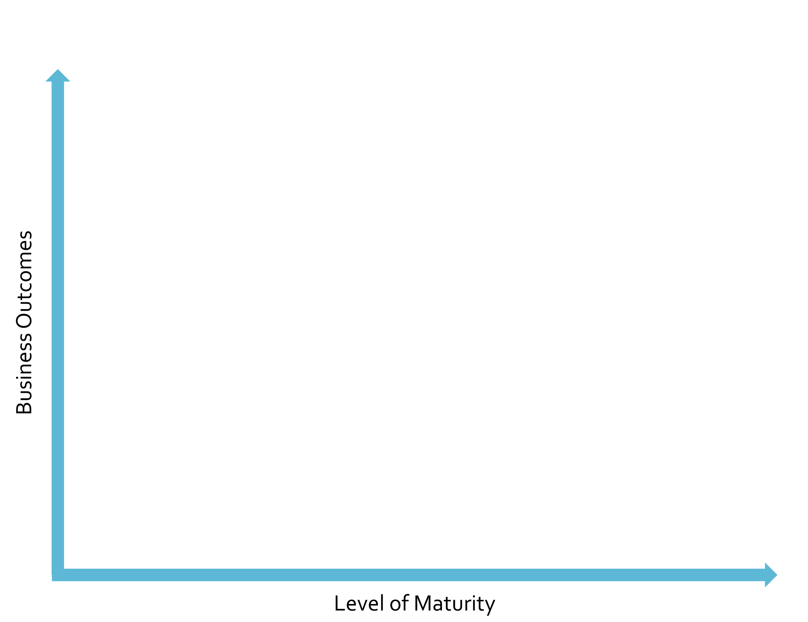
Gap Analysis
ERP [L3]
After
Current:
Mature IBM ERP
Average App
Ad-Hoc AI/ML
Future:
Superior App
Strong AI/ML
Block Chain
Mobile [L2]
Transformation
Now
Transformation
AI/ML [L1]
Now
Notes:
Note by Anderson: I made this slide to address the gap analysis and give us a strong vizual start using the framework from class.
Need to add references. Business Insights Maturity Model™ from week 3 slides. Existing ERP information: ftp://public.dhe.ibm.com/software/solutions/pdfs/g325-1334-00.pdf
Please let me know before making large changes to this slide. Happy to explain what it is.

Slide 5
Business Strategy:
Albertson’s business strategy is focussed on both the customers as well as the operations. According to its CEO Vivek Sankaran, the “four engines of its growth” are it’s stores, e-commerce, customer loyalty and private label. The first growth driver is their stores, a core of their business. It tries to enhance the everyday store operations with a strong focus on the customer experience along with the improvements in productivity. Their main goal is to provide their customers with a variety of the items they want, in stock and easy to find, with a seamless checkout experience.
Notes:
We continue to enhance our everyday store operations, with a strong focus on the customer experience as well as improvements in productivity,” he explained. “Ease of shopping is central to our approach. Our goal is to provide customers with a variety of the items they want, in stock and easy to find, with a seamless checkout experience.

Slide 6

Pillars of Strategy
(High Margin)
(Profitable)
Wholefoods
Our digital transformation will not only decrease costs, it will impact the competitive advantages from a value delivery to the customer. Which will be our first and foremost impact.
This competitive advantage will derive from the unique app features and more efficient shelf replenishing.
After
Transformation
Customer
Now
Safeway
Walmart
(Uncompetitive)
Operational
(High Volume)
Notes:
Note by Anderson: I made this slide to address the change in strategy, our plan is not coherent with their K10, example made with a modified framework from class.
Need to add references. Business Model & Strategy – Operating Model Reference Framework™ from week 1 slides.
Please let me know before making large changes to this slide. Happy to explain what it is.

Slide 7

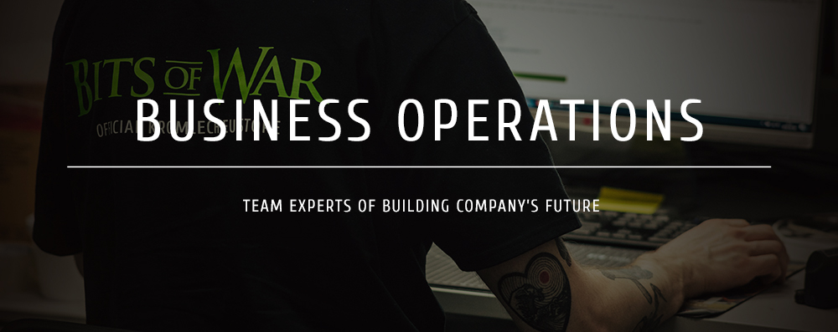

Who should drive the automation strategy?
The CIO’s Office would drive the automation strategy. And the project would be carried out by the strategy and innovation team.
Engineering Team

Slide 8
Focus/KPI | Delivery/Features
Reduce Out of Stock Time | Inventory Counter AI
Live shelf inventory tracking using the app (Customer Satisfaction) | Out of Stock App Feature with LDR Sensors
Customer Loyalty | Publicly Available Source/Supplier Tracking
Improved Supply chain management | Real time reporting through blockchain
License Technology to Followers | Strong Retail and AI Patents

Slide 9
What are the business functions impacted?
Product and Engineering: Engineer a unique solution using LDR sensor that keeps tab of count of products on the shelves.
Store operations: Enhance the in-store customer experience with integrated digital solutions.
Legal: Check for requirements in compliance, data privacy and Intellectual property rights.
Human Resources: Recruit and train employees to support smooth operations.
Finance: Allocate resource and create investment forecast for the transformation.
Customer Support: Maintain, repair and support store employees with technical issues.
Notes:
For safeway to have overall growth most business functions will have to work hand in hand

Slide 10
What is the operating model and capabilities required by Function?
Process - key is a functional and reliable Blockchain along with AI/ML model in order to execute the transformation.
System - Digital capability of LDR sensors to calculate count of inventory which further can be re-evaluated using image recognition via cameras in store.
Organization - Train store staff with new processes around technology and process change of inventory check.

Slide 11
Who should own the program roadmap?
Notes:
https://www.linkedin.com/in/vivekkalpande/
https://www.linkedin.com/in/anuj-dhanda-38bb814/
https://www.cnbc.com/anuj-dhanda-albertsons-technology-executive-council/

Slide 12

Persona:
Anuj Dhanda:
Anuj Dhanda is the EVP & CIO at Albertsons Safeway. Anuj has over 25 years of experience in leading business and technology functions in the financial services and retail industries.
Responsibilities: IT Architecture, Application platforms, data analytics, infrastructure and information security.
Notes:
Managing architecture, infrastructure and dta security

Slide 13

Persona:
Vivek Kalpande:
Vivek Kalpande is the VP of Customer Support and Experience Strategy, Product Management and Operations at Albertsons. Vivek has an experience in building a customer-centric culture in large organizations that delivers measurable business value.
Responsibilities: Marketing Strategy, Analytics, Product Operations
Notes:
Store front and customer experience

Slide 14
What about Policies: Privacy, Data, Security, integration, etc.?
Data Security - Should be compliant with adequate encryption throughout the data pipeline, making it virtually impossible to crack without the cryptographic key.
California Consumer Privacy Act - Stores in California should integrate CCPA, with which consumers will be able to opt out of the sale of their personal information. If a company fails to implement reasonable security practices and consumers' personal information is breached, they'll be allowed to sue those companies.
Notes:
2main ponints to be taken care are
To avoid any cyber security theft

Slide 15
Change Management
Internal
External
Store: Inventory Tracking=>Inventory Auditing Revisit Return Policies Accounting:
Centralized => Decentralized Private => Public
R&D:
Insight into how to use Blockchain Insight Into how to train and debug AI
Others:
Risk mitigation plan/disaster avoidance
Notes:
Internal vs External: https://diversified.consulting/article-is-internal-or-external-change-management-best-for-your-organization.html#:~:text=External%20change%20managers%20usually%20come,the%20consultancy%20firm's%20track%20record.

Slide 16
Human in the Loop
AI supported app features won’t have human support
Manual Inventory Checks: Once Per Shift
Internal Use Apps: Support/Debugging
Notes:
Notes on what to say: Keyword is Change Management Manual inventory check three times a day (once per shift): We need to work closely with stores to make sure they understand at each point how reliable the system is at each stage and how much human supervision/double checking the store should perform. This will required a phased change management policy. They need an app for them to quickly match the counts and “debug”. Restocking/inventory-shelving at night.

Slide 17
Build vs Buy
Blockchain
AI Models
In-House | Pro: Potentially designed to grant Safeway 100% of control. Con: Expensive, time consuming and less open.
Team with Walmart | Pro: Helps with the possibility of extending tracking to suppliers. Con: Harder to hard fork ledger in the future.
Use Ethereum | Pro: Proven blockchain that allows for smart contracts. Con: Might not accommodate transactions volume.
In-House | Pro: Flexible requirements, that can be customized as it goes. Con: Safeway lacks expertise in AI and risks being late.
Subcontract | Pro: Potentially quickest and cheapest option to market. Con: Hard to extend requirements. No know-how.
Acquisition | Pro: Injects AI experience and know-how into company. Con: May be expensive as software must still be adapted.
Notes:
Anderson’s Note: Maybe reformat in a way that the text is less tiny. Also write down our conclusion?

Slide 18
Roadmap Phases & Milestones
Parallel system, that uses AI to count items on shelves, and support app feature. Integrating decentralized count with blockchain tracking into ERP.
Milestone: parallel system has proven itself reliable.
Implementing auto-reordering per store based on count.
Milestone: system’s parameters tuned.
Licensing out to other stores as well as parent company (Albertsons).
Milestone: implement support team to aid companies using our system.
Notes:
Q3 2020 start
1st point takes 2 quarters, then 1 quarter for each of the subsequent ones. (time-slack/margin)

Slide 19
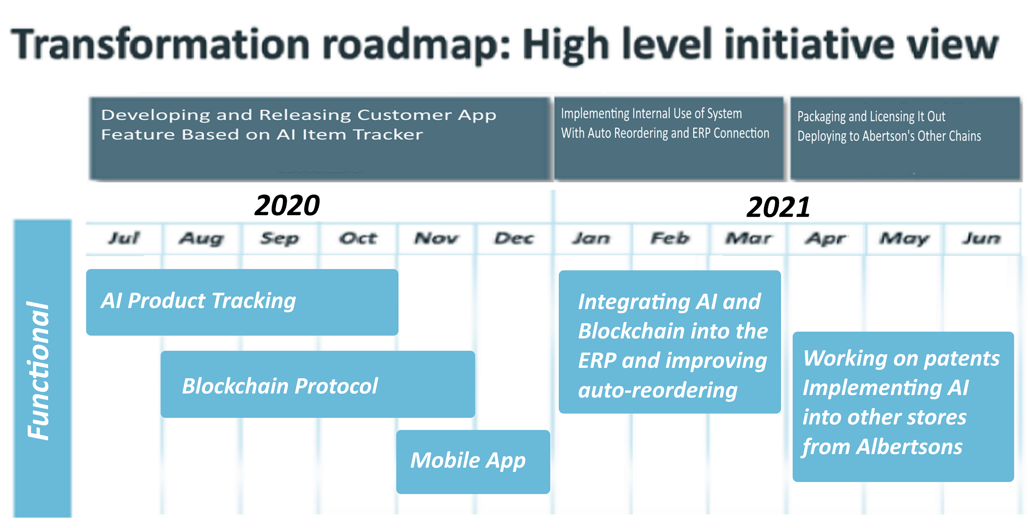

Slide 20
Future Scope
Customer app feature: heatmap in store of where desired item is located.
Employee app feature: track items that have been misplaced by customers.
Marketing data idea: tracking customer journeys with path and items picked.
Cashierless checkout: precisely identifying buyers, items, and detecting theft.

Slide 21
Conclusion/Ask/Call to Action
In the context of the technology transition towards AI Automation derived from advances in ML, it is imperative Safeway moves forward with its new initiative. This will place them ahead of the competition, including Walmart, Amazon, Wholefoods and others who are already taking very active digital strategies. Effective digital transformation will allow Safeway to increase its market share and profits.
Notes:
Conclusion/Ask/Call to Action

Slide 22

Thank You !!!!!!

Slide 23
Planning and Backup Slides

Slide 24
USEFUL SOURCES:
Data Visualization Helps Safeway Keep Shelves Stocked:
https://deloitte.wsj.com/cio/2013/12/03/data-visualization-helps-safeway-improve-inventory-management/
“With help from PepsiCo, the $44 billion grocery chain looks to new technology to solve age-old retail challenges—and sees tangible operational improvements as a result.”
Notes:
Anderson’s Note: Please do not delete, but feel free to add more sources, quotes and slides!!!

Slide 25
Process capabilities
Massive transformation:
Store Operators are very involved!!!
Blockchain?
System Capabilities?

Slide 26
Capabilities and Policies
Key activities required to execute on business strategy will need the organization to define the process capabilities by business function.
Process capabilities require digital / system capabilities to be designed and built or developed/configured.
And Policies...
Look into class slides!
Strategy/Frameworks
This will impact to some extent every department. (not just R&D, and specially impacted will be the stores)

Slide 27
Key activities & Policies
Inventory conciliation
How to manage returns (change management map)
Listing:
Re-evaluating the count on the shelves
Departments?

Slide 28
Policies
Conciliating inventory
How to manage returns (change management map)
(loss)

Slide 29
Human in the Loop
Deciding cutoff points/margins for error.
Periodic human update? Yes
Support for app feature? Yes
Impact of feature into store clerk customer help requests?
Figure Strategy
Draw Flowchart Determine industry benchmark for error Justify APP and Manual Update with sources/argument

Slide 30
Human in the Loop (app)
No humans apply

Slide 31
Vendor Options
Connecting to ERP? Yes
Tapping into existing blockchain? (Walmart, Ethereum, etc) Maybe
ML Company for development of AI? Look into it
Add a Matrix ( comparing options of vendors)

Slide 32
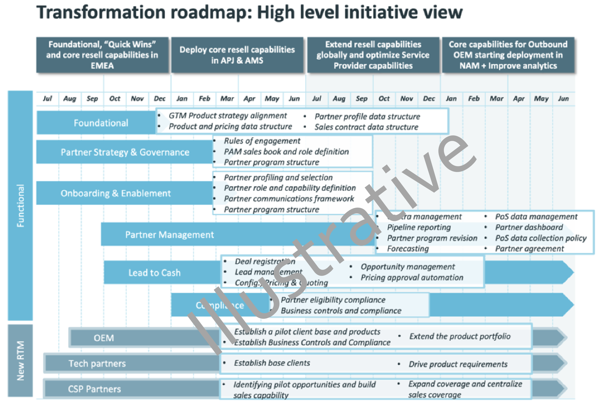
Roadmap
Don't be exhaustive on the roadmap. Make one.
Data design/data modeling. Simpler than this:

